Slide 1

NETFLIX DATA ANALYSIS WITH PYTHON
Presenters:
Miss. Tahseen Begum_2010030168
Miss. Keerthana Pulugam_2010030445
Miss. Pravallika_201003004
Miss. Sowgna_2010030344
Guide: Chanda Raj Kumar Rao

Slide 2
Outline
Documentation Results
Github commits
Code Reproducibility
Working Prototype

Slide 3
Introduction
Netflix is one of the largest providers of online streaming services. It collects a huge amount of data because it has a very large subscriber base. In this article, I’m going to introduce you to a data science project on Netflix data analysis with Python.
We can analyze a lot of data and models from Netflix because this platform has consistently focused on changing business needs by shifting its business model from on-demand DVD movie rental and now focusing a lot about the production of their original shows.

Slide 4
Problem Statement
I’ll take a look at some very important models of Netflix data to understand what’s best for their business. Some of the most important tasks that we can analyze from Netflix data are:
Understand what content is available
Understand the similarities between the content
Understand the network between actors and directors
What exactly Netflix is focusing on
Sentiment analysis of content available on Netflix.

Slide 5
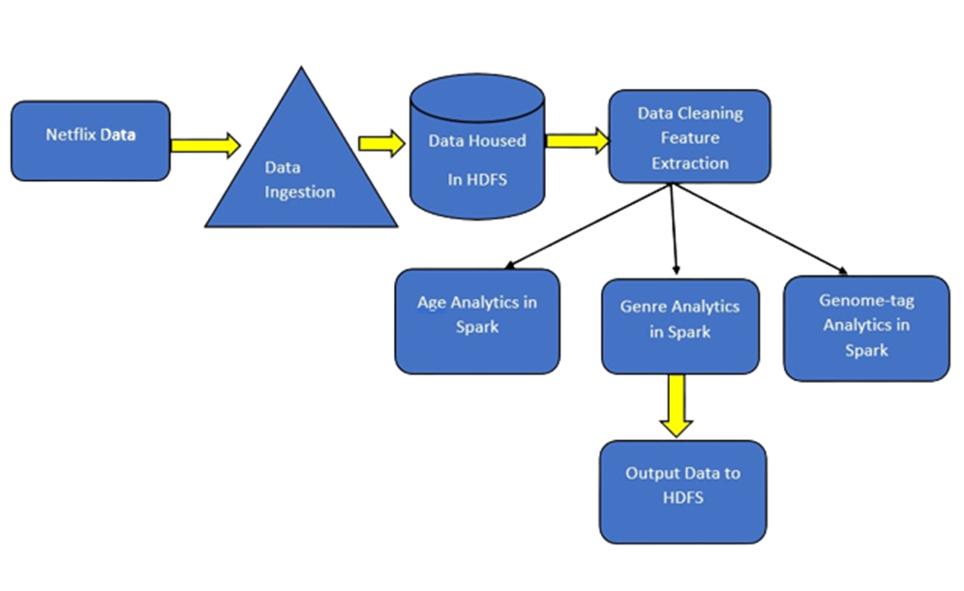
Flowchart

Slide 6
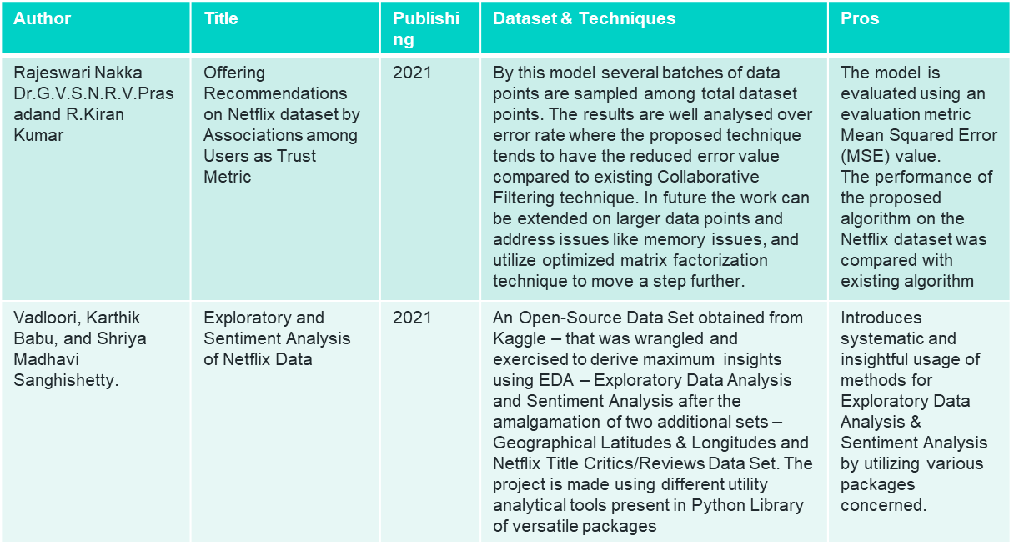
Literature Survey

Slide 7
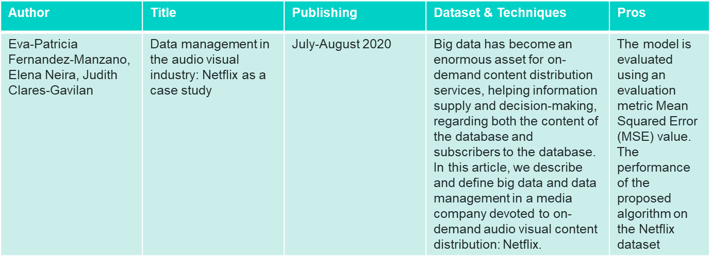

Slide 8
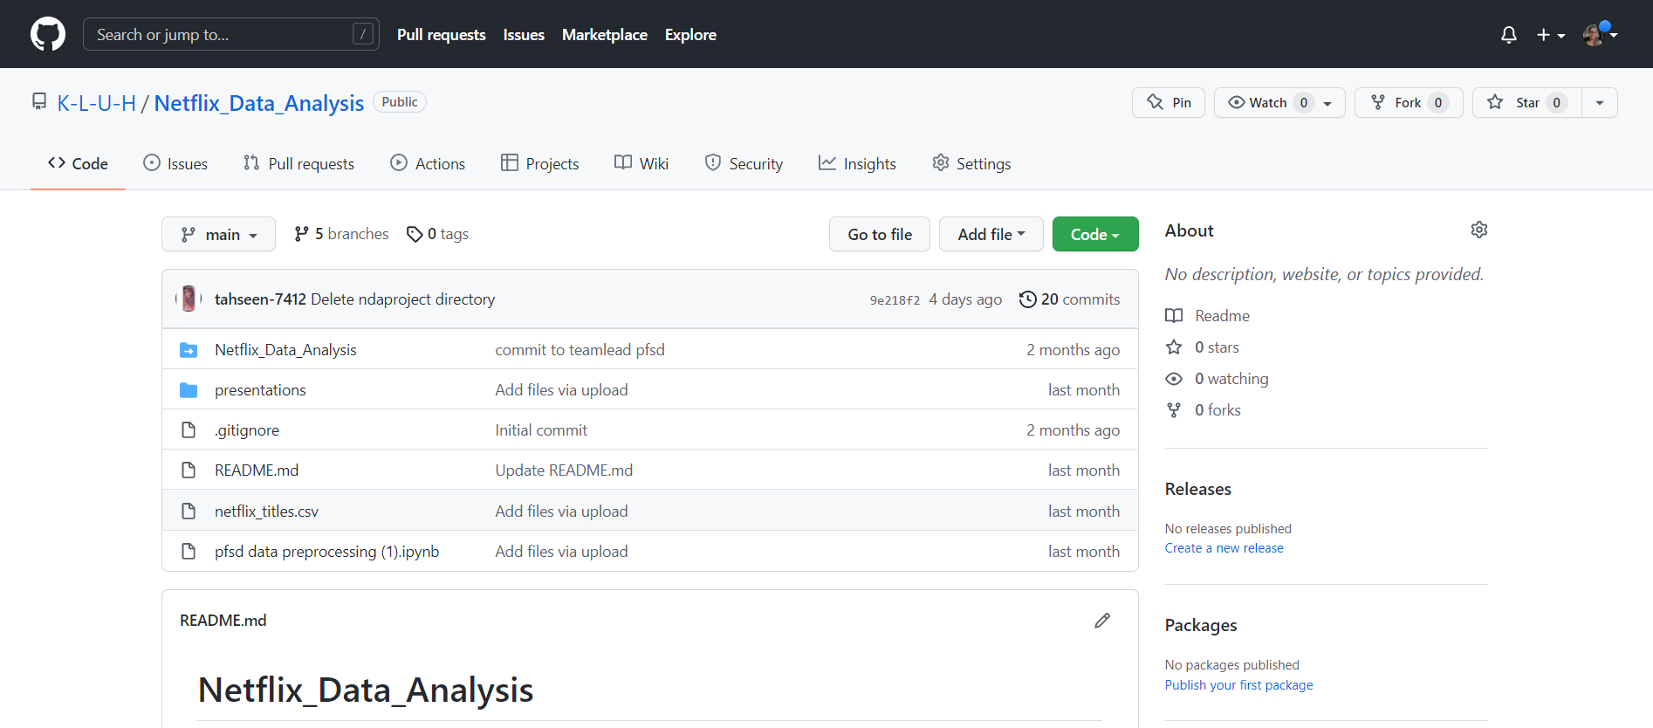
Github commits

Slide 9
Code reproducibility
Step-1:
!pip install matplotlib
Step-2:
#importing the dataset
import numpy as np # linear algebra
import pandas as pd # data processing, CSV file I/O (e.g. pd.read_csv)
import matplotlib.pyplot as plt
Step-3:
#to import csv file
netflix_data = pd.read_csv(r"C:\Users\Sowgn\OneDrive\Desktop\pfsd\netflix_titles.csv")
Step-4:
netflix_data
Step-5:
#head function
#to show top-5 records of the dataset
netflix_data.head()
Step-6:
#tail function
#to show bottom-5 records of dataset
netflix_data.tail()
Step-7:
#shape
#to show no of rows and colums
netflix_data.shape
Step-8:
#size
#to show no of total values(elements) in the dataset
netflix_data.size
Step-9:
netflix_data.columns
Step-10:
netflix_data.dtypes

Slide 10
Code reproducibility
Step-11:
netflix_data.info()
Step-12:
netflix_data.value_counts()
Step-13:
netflix_data.nunique()
Step-14:
netflix_data[netflix_data.duplicated()]
Step-15:
netflix_data.drop_duplicates()
Step-16:
netflix_data.isnull()
Step-17:
netflix_data.isnull().sum()
Step-18:
!pip install seaborn
Step-19:
import seaborn as sns
Step-20:
sns.heatmap(netflix_data.isnull())
Step-21:
netflix_data[netflix_data['title'].isin(['Blood & Water’])]
Step-22:
netflix_data['Date_N']=pd.to_datetime(netflix_data['date_added’])
Step-23:
netflix_data.head()
Step-24:
netflix_data['Date_N'].dt.year.value_counts()
Step-25:
netflix_data['Date_N'].dt.year.value_counts().plot(kind='bar’)
Step-26:
netflix_data.groupby('type').type.count()

Slide 11
Code reproducibility
<!DOCTYPE html>
<html>
<head>
<meta name="viewport" content="with=device-width, initial-scale=1.0">
<title>Netflix Data Analysis</title>
<link rel ="stylesheet" href="style.css">
<link rel="preconnect" href="https://fonts.googleapis.com">
<link rel="preconnect" href="https://fonts.gstatic.com" crossorigin>
<link href="https://fonts.googleapis.com/css2?family=Poppins:wght@100;200;300;400;600;700&display=swap" rel="stylesheet">
<link rel="stylesheet" href="https://stackpath.bootstrapcdn.com/font-awesome/4.7.0/css/font-awesome.min.css">
</head>
<body>
<section class="sub-header">
<nav

Slide 12
Code reproducibility
<i class="fa fa-times-circle" onclick="hideMenu()"></i>
<ul>
<li><a href="index.html">HOME</a></li>
<li><a href="about.html">ABOUT</a></li>
<li><a href="movie.html">MOIVES</a></li>
<li><a href="data_analysis.html">ANALYSIS</a></li>
<li><a href="https://github.com/K-L-U-H/Netflix_Data_Analysis/blob/main/pfsd%20data%20preprocessing%20(1).ipynb">DATA ANALYSIS</a></li>
<li><a href="https://github.com/K-L-U-H/Netflix_Data_Analysis">PROJECT SOURCE</a></li>
<li><a href="contact.html">CONTACT</a></li>
</ul>
</div>
<i class="fa fa-bars" onclick="showMenu()"></i>
</nav>
<h1>About Us</h1

Slide 13
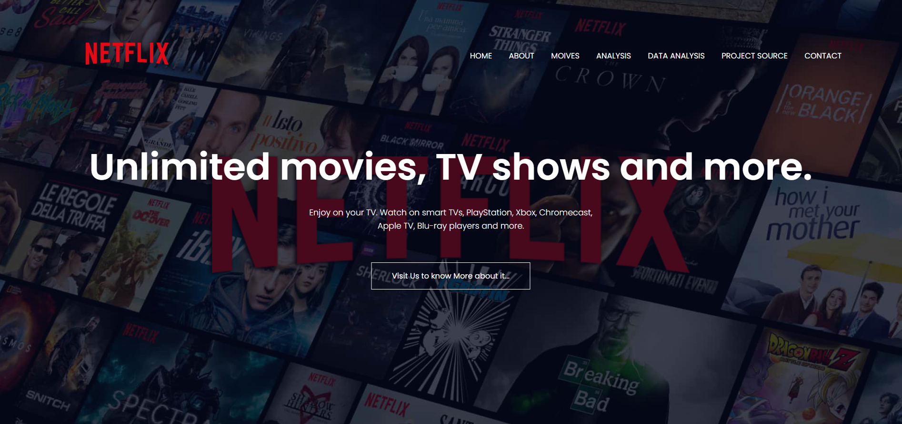
Working Protype

Slide 14
THANK YOU

